Slide 1
UNIT 4
Graph Theory

Slide 2
Graph basics
A graph G consists of two things:
A set V = V (G) whose elements are called vertices, points, or nodes of G.
A set E = E(G) of unordered pairs of distinct vertices called edges of G.
We denote such a graph by G(V,E) when we want to emphasize the two parts of G.

Slide 3
Vertices u and v are said to be adjacent or neighbors if there is an edge e = {u, v}.
In such a case, u and v are called the endpoints of e, and e is said to connect u and v.
Also, the edge e is said to be incident on each of its endpoints u and v.

Slide 4
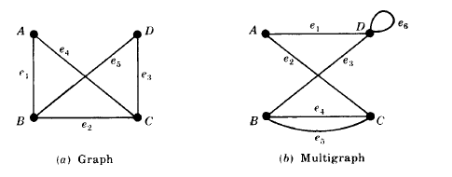
Example of Graph & Multigraph
V consists of vertices A, B, C, D.
E consists of edges e1 = {A,B}, e2 = {B,C}, e3 = {C,D}, e4 = {A,C}, e5 = {B,D}.

Slide 5
The edges e4 and e5 are called multiple edges since they connect the same endpoints, and the edge e6 is called a loop since its endpoints are the same vertex. Such a diagram is called a multigraph.
The formal definition of a graph permits neither multiple edges nor loops.
Thus a graph may be defined to be multigraph without multiple edges or loops.

Slide 6
Degree of a Vertex
The degree of a vertex v in a graph G, written deg (v), is equal to the number of edges in G which contain v, that is, which are incident on v.

Slide 7
Theorem 1
The sum of the degrees of the vertices of a graph G is equal to twice the number of edges in G.
deg(A) = 2, deg(B) = 3, deg(C) = 3, deg(D) = 2.
The sum of the degrees equals 10 which, as expected, is twice the number of edges.
A vertex is said to be even or odd according as its degree is an even or an odd number.
Thus A and D are even vertices whereas B and C are odd vertices.

Slide 8
Finite Graphs, Trivial Graph
A multigraph is said to be finite if it has a finite number of vertices and a finite number of edges.
Observe that a graph with a finite number of vertices must automatically have a finite number of edges and so must be finite.
The finite graph with one vertex and no edges, i.e., a single point, is called the trivial graph.

Slide 9
SUBGRAPHS, ISOMORPHIC AND HOMEOMORPHIC GRAPHS
Consider a graph G = G(V,E).
Agraph H = H(V,E ) is called a subgraph of G if the vertices and edges of H are contained in the vertices and edges of G, that is, if V ⊆ V and E ⊆ E.
In particular:
(i)A subgraph H(V,E) of G(V,E) is called the subgraph induced by its vertices V if its edge set E contains all edges in G whose endpoints belong to vertices in H.
(ii) If v is a vertex in G, then G − v is the subgraph of G obtained by deleting v from G and deleting all edges in G which contain v.
(iii) If e is an edge in G, then G − e is the subgraph of G obtained by simply deleting the edge e from G.

Slide 10
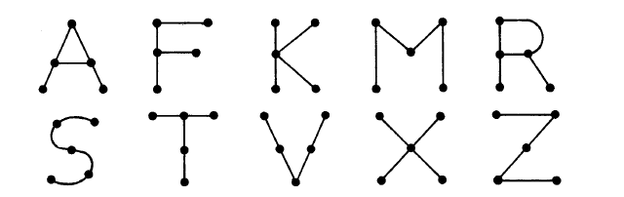
Isomorphic Graphs
Graphs G(V,E) and G(V ∗,E∗) are said to be isomorphic if there exists a one-to-one correspondence f : V → V∗ such that {u, v} is an edge of G if and only if {f (u), f (v)} is an edge of G∗.
We note that A and R are isomorphic graphs. Also, F and T are isomorphic graphs, K and X are isomorphic graphs and M, S, V , and Z are isomorphic graphs.

Slide 11
Homeomorphic Graphs
Given any graph G, we can obtain a new graph by dividing an edge of G with additional vertices.
Two graphs G and G∗ are said to homeomorphic if they can be obtained from the same graph or isomorphic graphs by this method.

Slide 12
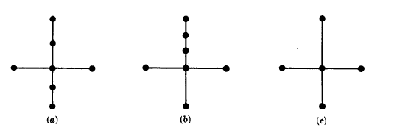
The graphs (a) and (b) in Fig. are not isomorphic, but they are homeomorphic since they can be obtained from the graph (c) by adding appropriate vertices.

Slide 13
PATHS, CONNECTIVITY
A path in a multigraph G consists of an alternating sequence of vertices and edges of the form v0, e1, v1, e2, v2, . . . , en−1, vn−1, en, vn where each edge ei contains the vertices vi−1 and vi (which appear on the sides of ei in the sequence).
The number n of edges is called the length of the path.
When there is no ambiguity, we denote a path by its sequence of vertices (v0, v1, . . . , vn).
The path is said to be closed if v0 = vn.
A simple path is a path in which all vertices are distinct. (A path in which all edges are distinct will be called a trail.)
A cycle is a closed path of length 3 or more in which all vertices are distinct except v0 = vn.
A cycle of length k is called a k-cycle.

Slide 14
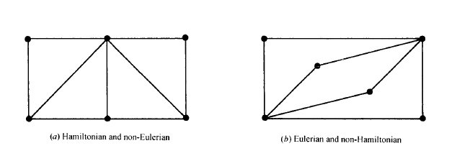
Hamiltonian Graphs
The above discussion of Eulerian graphs emphasized traveling edges; here we concentrate on visiting vertices.
A Hamiltonian circuit in a graph G, named after the nineteenth-century Irish mathematician William Hamilton, is a closed path that visits every vertex in G exactly once.
If G does admit a Hamiltonian circuit, then G is called a Hamiltonian graph.
Note that an Eulerian circuit traverses every edge exactly once, but may repeat vertices, while a Hamiltonian circuit visits each vertex exactly once but may repeat edges. Fig. gives an example of a graph which is Hamiltonian but not Eulerian, and vice versa.

Slide 15
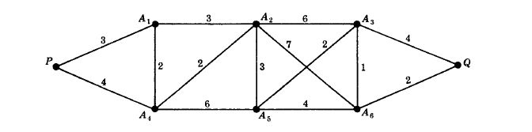
LABELED AND WEIGHTED GRAPHS
A graph G is called a labeled graph if its edges and/or vertices are assigned data of one kind or another.
In particular, G is called a weighted graph if each edge e of G is assigned a nonnegative number w(e) called the weight or length of v.

Slide 16
COMPLETE, REGULAR, AND BIPARTITE GRAPHS
Complete Graphs
A graph G is said to be complete if every vertex in G is connected to every other vertex in G. Thus a complete graph G must be connected. The complete graph with n vertices is denoted by Kn. Fig. shows the graphs K1 through K6.

Slide 17
Regular Graphs
A graph G is regular of degree k or k-regular if every vertex has degree k. In other words, a graph is regular if every vertex has the same degree.
The connected regular graphs of degrees 0, 1, or 2 are easily described.
The connected 0-regular graph is the trivial graph with one vertex and no edges.
The connected 1-regular graph is the graph with two vertices and one edge connecting them.
The connected 2-regular graph with n vertices is the graph which consists of a single n-cycle.

Slide 18
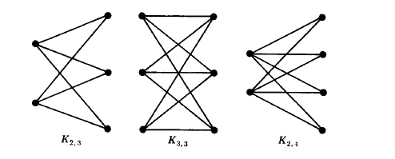
Bipartite Graphs
A graph G is said to be bipartite if its vertices V can be partitioned into two subsets M and N such that each edge of G connects a vertex of M to a vertex of N.
By a complete bipartite graph, we mean that each vertex of M is connected to each vertex of N; this graph is denoted by Km , n where m is the number of vertices in M and n is the number of vertices in N, and, for standardization, we will assume
m ≤ n.

Slide 19
TREE GRAPHS
A graph T is called a tree if T is connected and T has no cycles.
A forest G is a graph with no cycles; hence the connected components of a forest G are trees.
A graph without cycles is said to be cycle-free. The tree consisting of a single vertex with no edges is called the degenerate tree.
Consider a tree T . Clearly, there is only one simple path between two vertices of T ; otherwise, the two paths would form a cycle. Also:
(a) Suppose there is no edge {u, v} in T and we add the edge e = {u, v} to T . Then the simple path from u to v in T and e will form a cycle; hence T is no longer a tree.
(b) On the other hand, suppose there is an edge e = {u, v} in T , and we delete e from T . Then T is no longer connected (since there cannot be a path from u to v); hence T is no longer a tree.

Slide 20
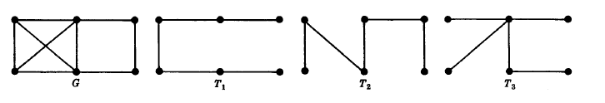
Spanning Trees
A subgraph T of a connected graph G is called a spanning tree of G if T is a tree and T includes all the vertices of G.
Fig. shows a connected graph G and spanning trees T1, T2, and T3 of G.

Slide 21
Minimum Spanning Trees
Suppose G is a connected weighted graph. That is, each edge of G is assigned a nonnegative number called the weight of the edge.
Then any spanning tree T of G is assigned a total weight obtained by adding the weights of the edges in T.
A minimal spanning tree of G is a spanning tree whose total weight is as small as possible.

Slide 22
GRAPH ALGORITHMS
One is called a depth-first search (DFS) and the other is called a breadth-first search (BFS)

Slide 23
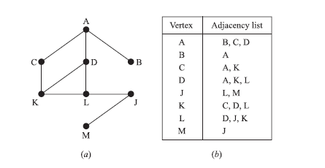

Slide 24
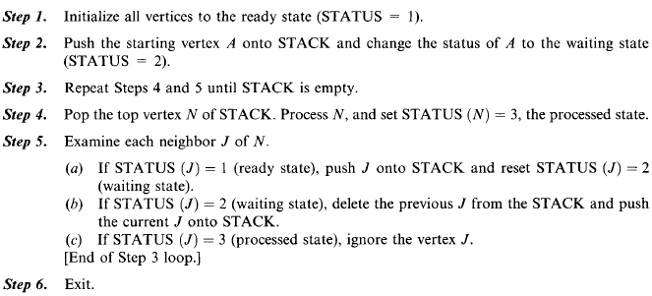

Slide 25
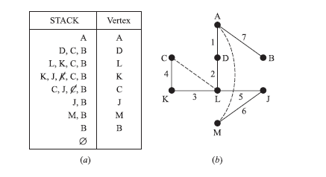
DFS Example
The vertices will be processed in the following order:
A, D, L, K, C, J, M, B

Slide 26
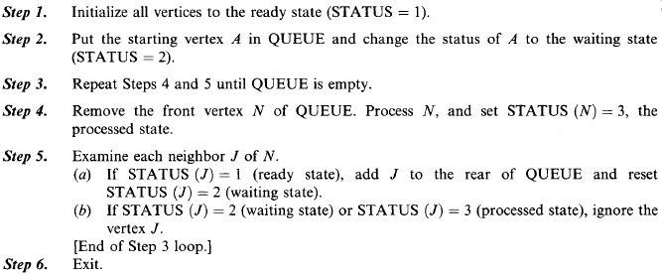
BFS

Slide 27
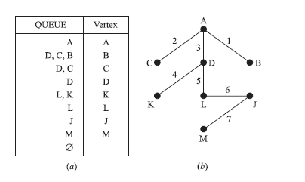
BFS Example

Slide 28
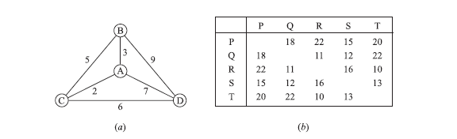
Theorem
The complete graph Kn with n ≥ 3 vertices has H = (n − 1)!/2 Hamiltonian circuits.

Slide 29
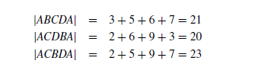
Thus ACDBA with weight 20 is the Hamiltonian circuit of minimum weight.

Slide 30
Graph coloring problem
Consider a graph G.
A vertex coloring, or simply a coloring of G is an assignment of colors to the vertices of G such that adjacent vertices have different colors.
We say that G is n-colorable if there exists a coloring of G which uses n colors.
The minimum number of colors needed to paint G is called the chromatic number of G and is denoted by χ(G).

Slide 31
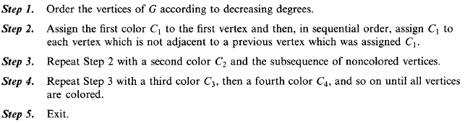
an algorithm by Welch and Powell for a coloring of a graph G

Slide 32
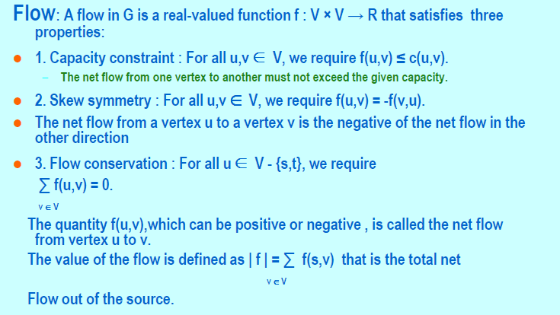
FORD FULKERSON Algorithm

Slide 33
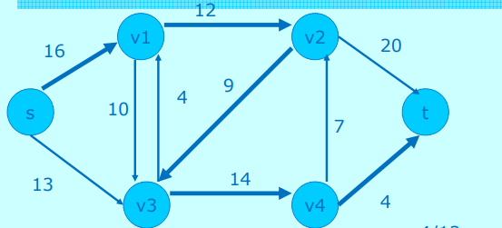
Max Flow - Min Cut Theorem

Slide 34
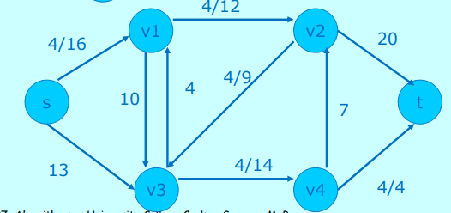

Slide 35
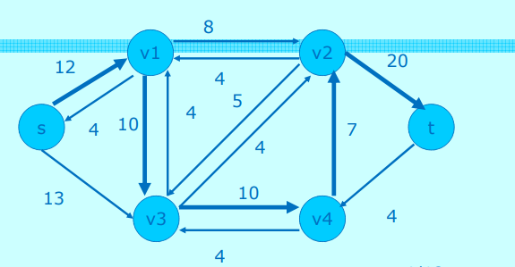

Slide 36
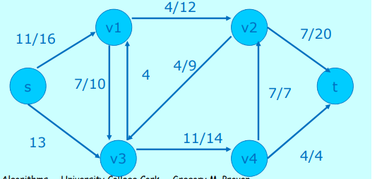

Slide 37
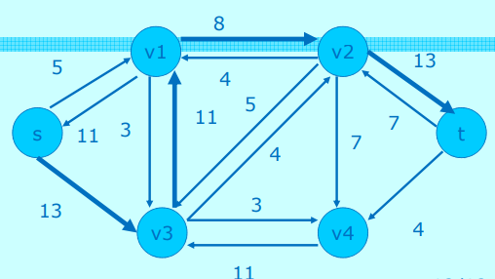

Slide 38
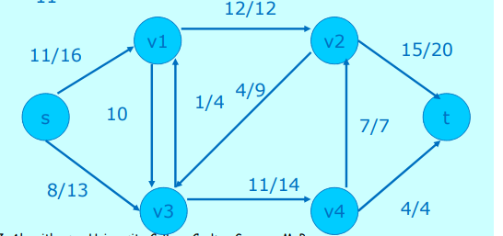

Slide 39
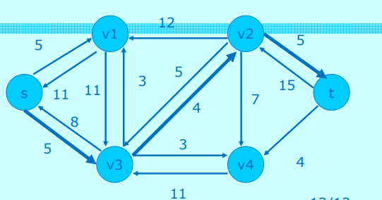

Slide 40
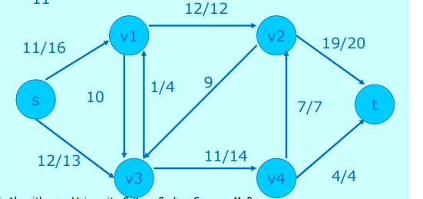

Slide 41
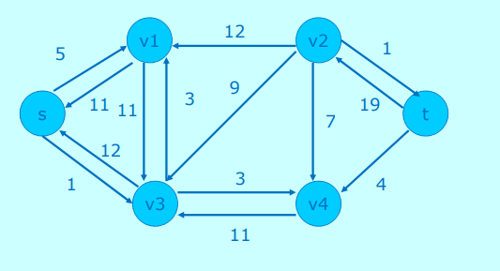

Slide 42
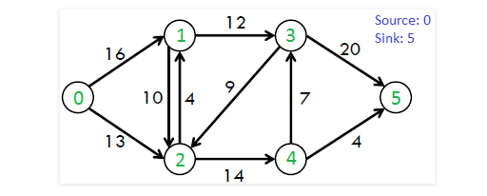
Max Flow - Min Cut Theorem

Slide 43
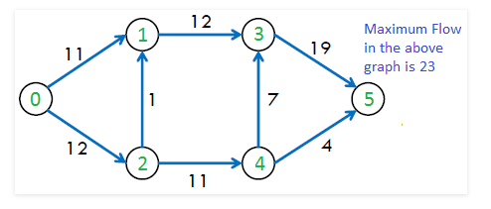
Solution

